Slide 1

August 7, 2025
BUSINESS INTELLIGENCE & ANALYTICS TRANSFORMATION
EASON SONS & LTD
Liton Nath - x23402661
Olamide Abioro - x23428902
Muhammad Osama Hassan Khan - x24137782

Slide 2


Motivation & Project Background
Eason Sons & Ltd, a leading Irish retailer, faced operational inefficiencies, fragmented data, and declining sales due to fierce competition and changing consumer behavior.
Aim
Modernize processes, regain profitability, and improve customer experience using integrated BI (Power BI) and CRM (Salesforce) solutions.

Slide 3



Project Overview
Developed an end-to-end BI and CRM system.
Salesforce
Power BI
Centralizes customer data, sales, inventory, and staff records
Provides real-time analytics and dashboards for decision support.
Data sources: Mockaroo-generated datasets

Slide 4

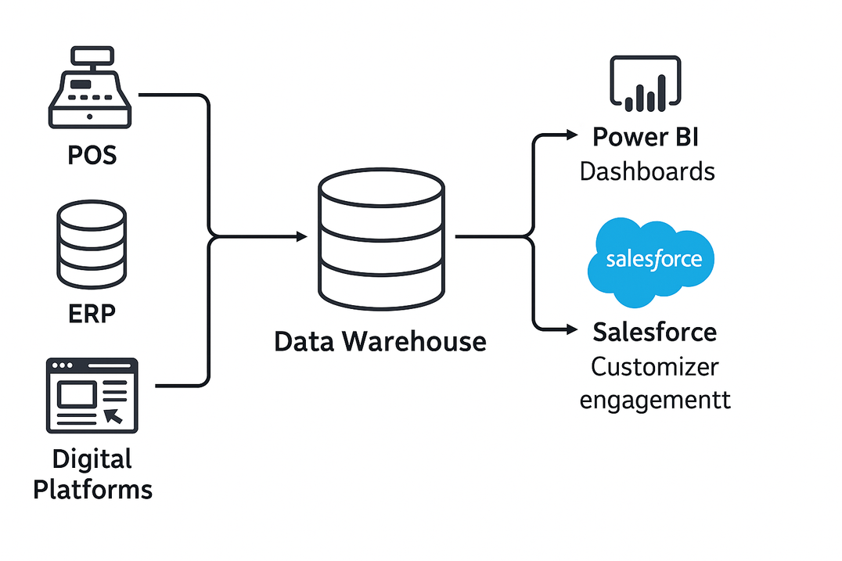
System Architecture & Data Flow

Slide 5
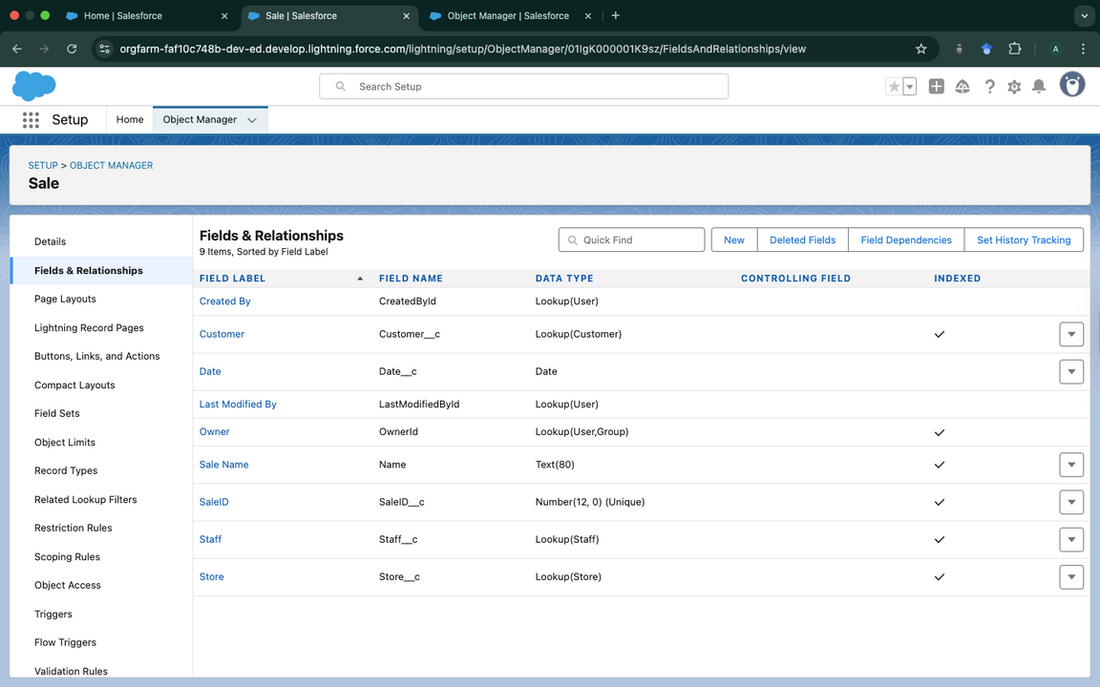
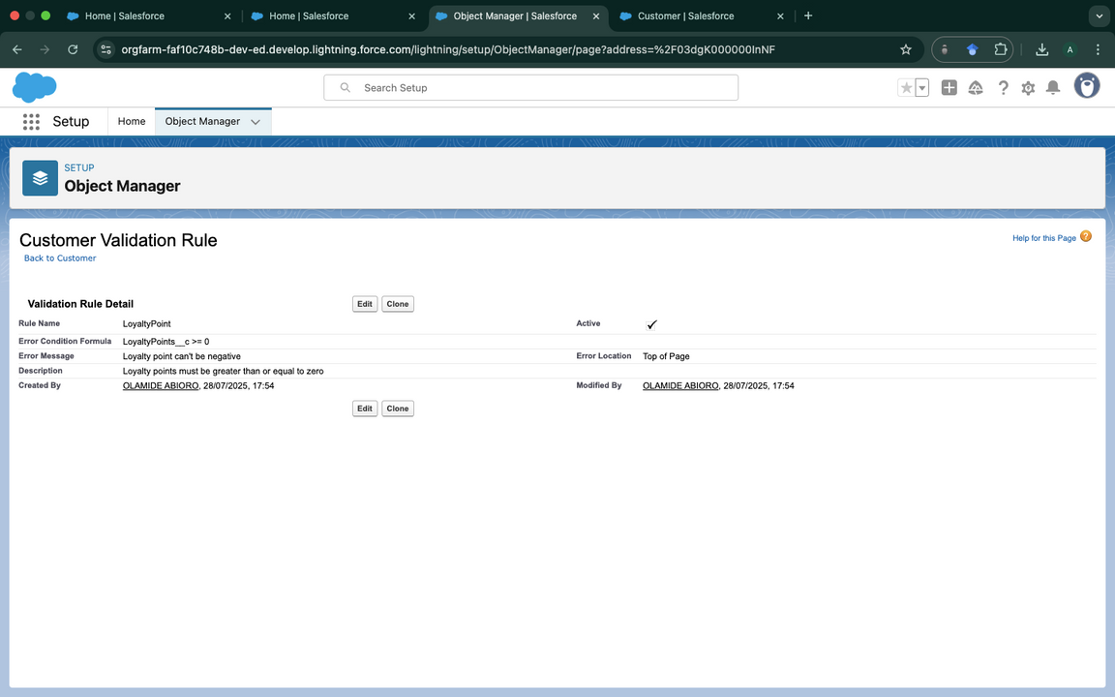
Salesforce Implementation
Custom Objects
Validation Rules
Customers, Sales, Products, Staff, Inventory, Stores.
Example – Customer object holds LoyaltyPoints, Marketing Consent; Sales links to Customer and Store via lookups.
Validation rules were set to maintain data integrity. For instance, a validation rule for the Customer object was established to ensure that loyalty points cannot be negative

Slide 6
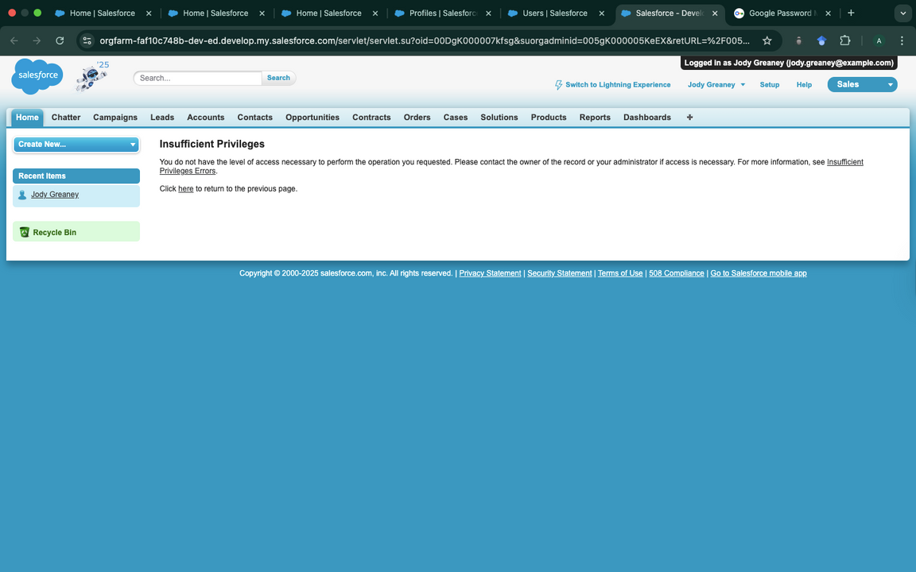
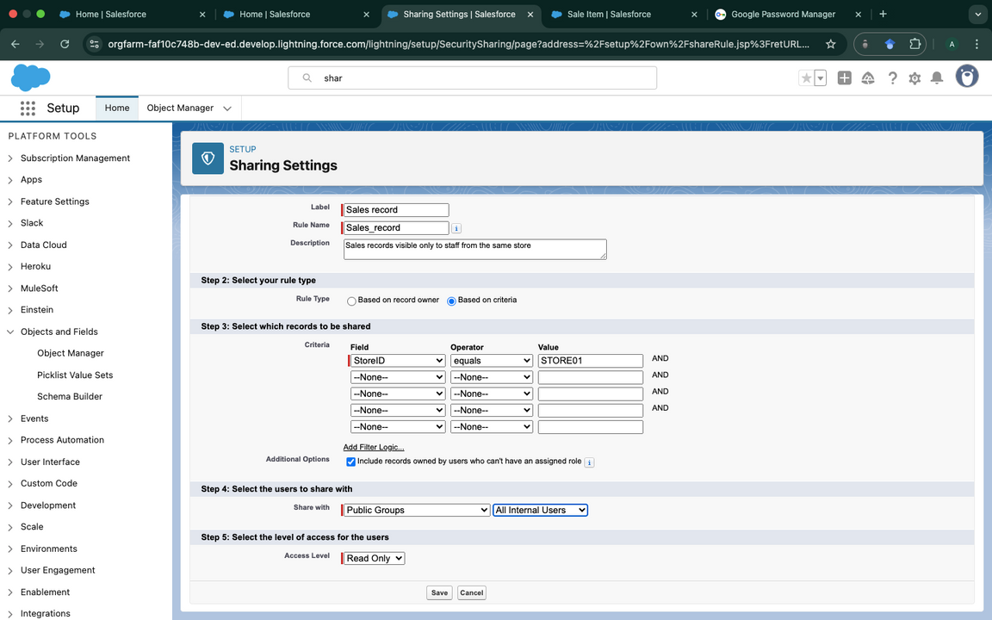
Salesforce Implementation Continuation
Access Controls
Sharing Rules
Profiles were carefully configured to ensure users had appropriate acces. E.g Limited access to a staff trying to access other staff data
Sharing rules were defined to ensure store-specific data visibilit. E.g Staff see only their store’s data

Slide 7

Power BI Implementation
Connection: Power BI links to PostgreSQL.
Data Model: Seven normalized tables, manual relationship setup.
KPI and DAX Example:
customer_Segment =
SWITCH(
TRUE(),
SELECTEDVALUE(’public cust’[loyaltypoints]) < 100, "Bronze",
SELECTEDVALUE(’public cust’[loyaltypoints]) >= 100 && SELECTEDVALUE(
SELECTEDVALUE(’public cust’[loyaltypoints]) > 300, "Platinum"
)

Slide 8
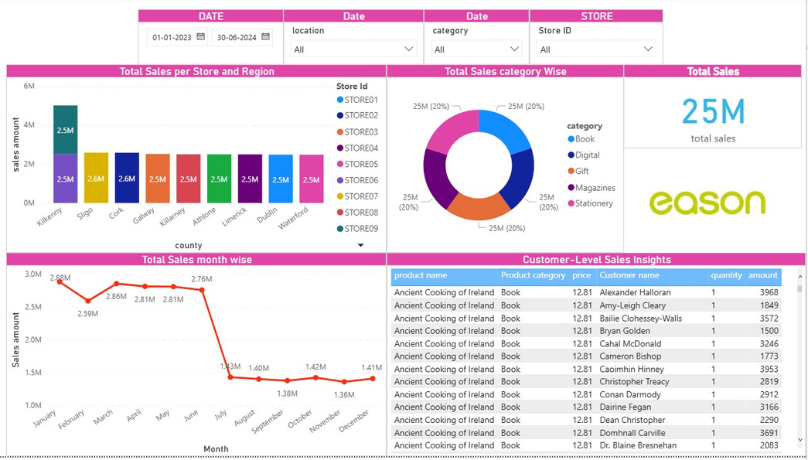
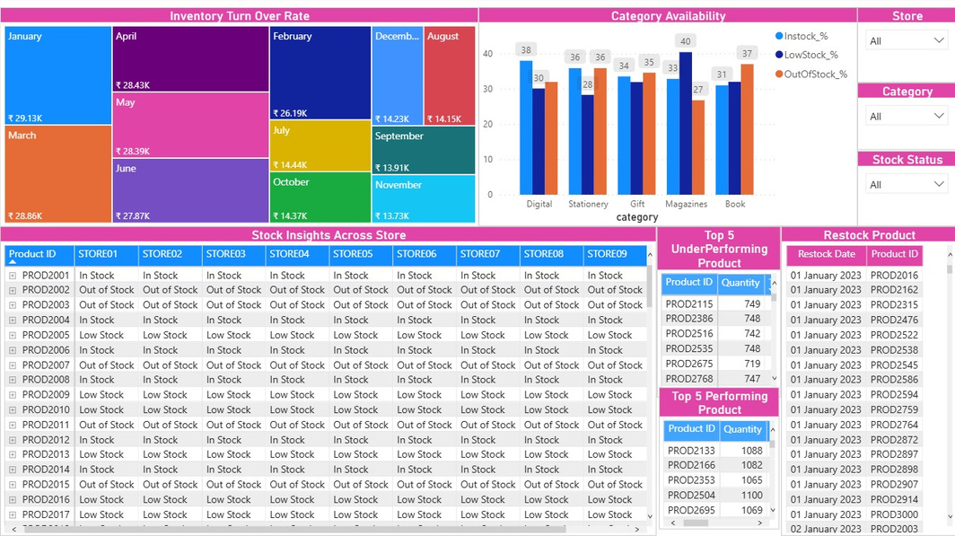
Dashboards
Sales Dashboard
Inventory Dashboard
The Power BI dashboard offers an interactive overview of sales from January 2023 to June 2024, enabling detailed analysis by time, product, location, and customer behavior.
The inventory dashboard enables detailed analysis of product availability and turnover across
stores.

Slide 9


Main Insights & Business Impact
Sales: Strong seasonality, actionable via targeted Q3/Q4 promotions.
Inventory: Chronic understocking, requiring automated replenishment.
Customer: Low retention, need for loyalty campaigns and better segmentation.
Improved operational efficiency, data quality, and staff productivity.
Enhanced data security and compliance through profile-based access.

Slide 10

THANK YOU
FOR YOUR ATTENTION

